Slide 1
ML Consult
goofy ahh slide deck

Slide 2
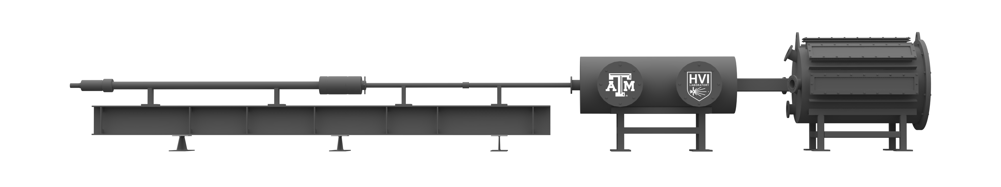
Figure 1
Downrange
Uprange
Muzzle
Central Breech
Sabot Stopping Plate
Powder Breech
Target Tank
Blast Tank
Flight Tube
Pump Tube
Figure 1: The two-stage light gas gun (2SLGG), with necessary dimensions, located in the TAMU HVI Laboratory. The key components of concern in this work are the muzzle, blast tank, and sabot stopping plate (SSP).
1.2 m
y
2.4 m
z
13.7 m

Slide 3
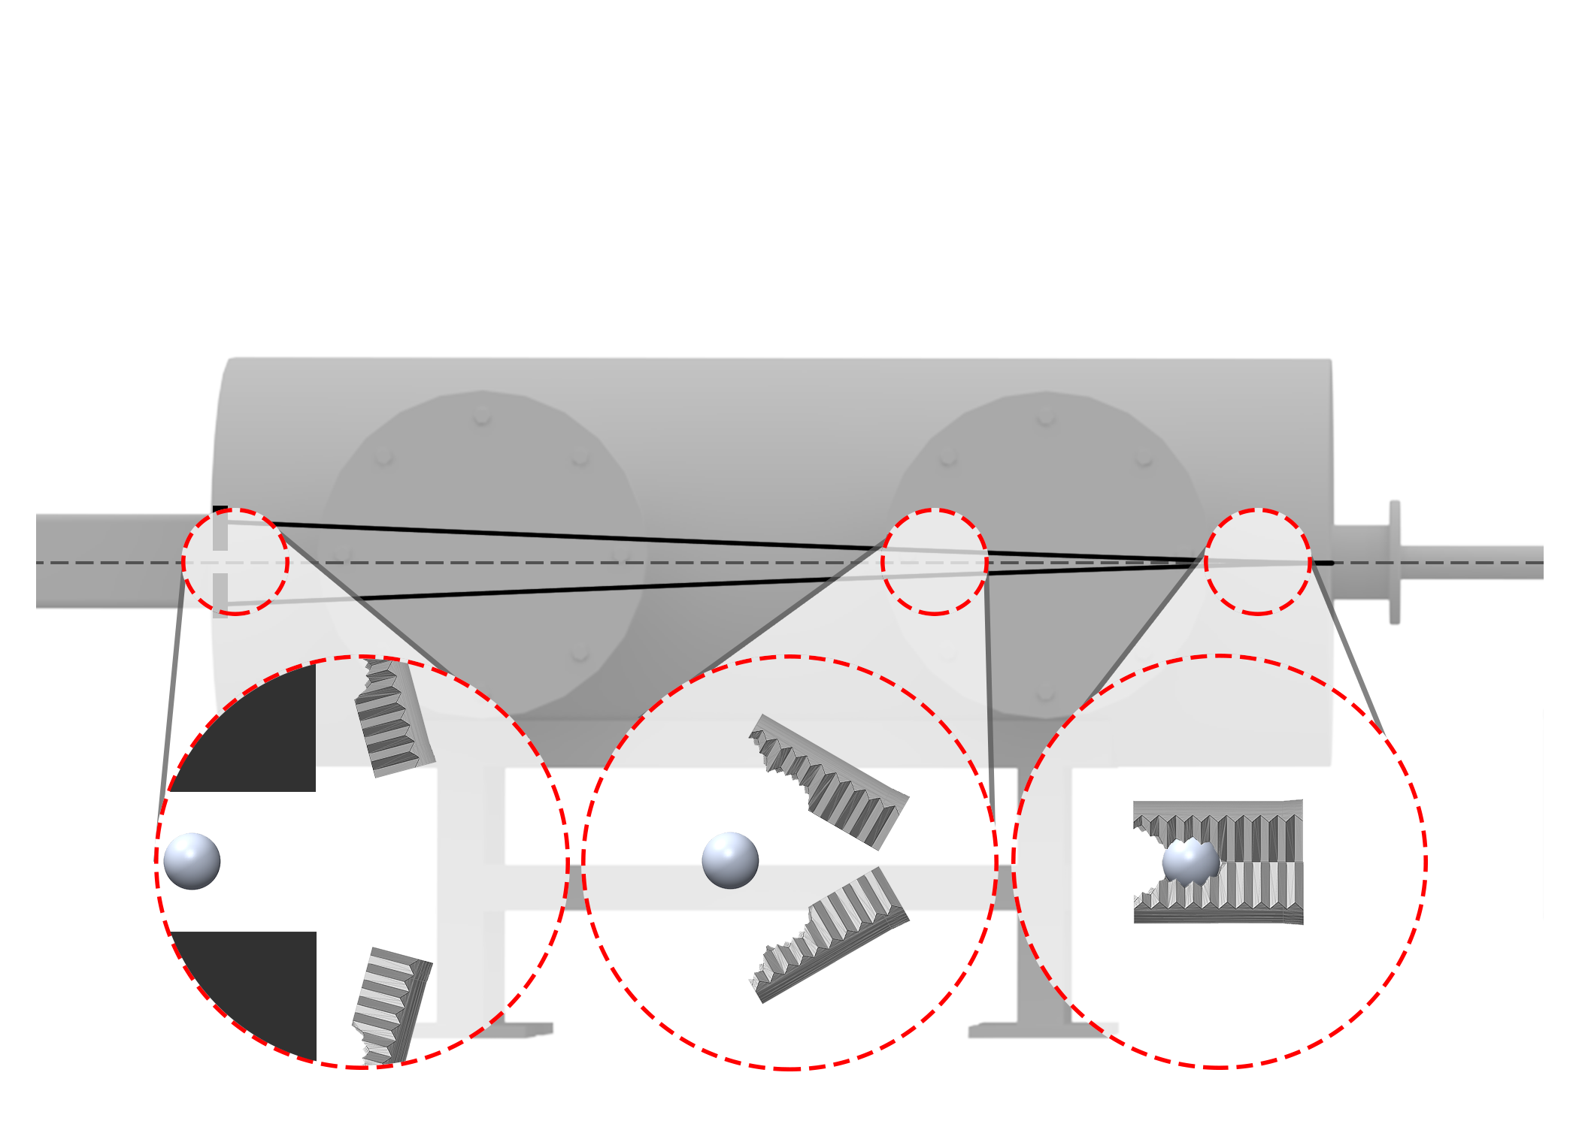
Figure 3
Downrange
Axis of Projectile Flight (AoPF)
Uprange
Sabot stopping plate (SSP)
Sabot flight path
Drift Tube
Blast Tank
Figure 3: The main sequence of events during aerodynamic sabot separation: (1) projectile package exits the 2SLGG launch tube muzzle, (2) sabot petals aerodynamically separate from the projectile, and (3) the sabot petals impact the sabot stopping plate (SSP) as the projectile enters drift tube. Only two sabot petals are shown for visualization purposes.
y
z
(3)
(2)
(1)

Slide 4
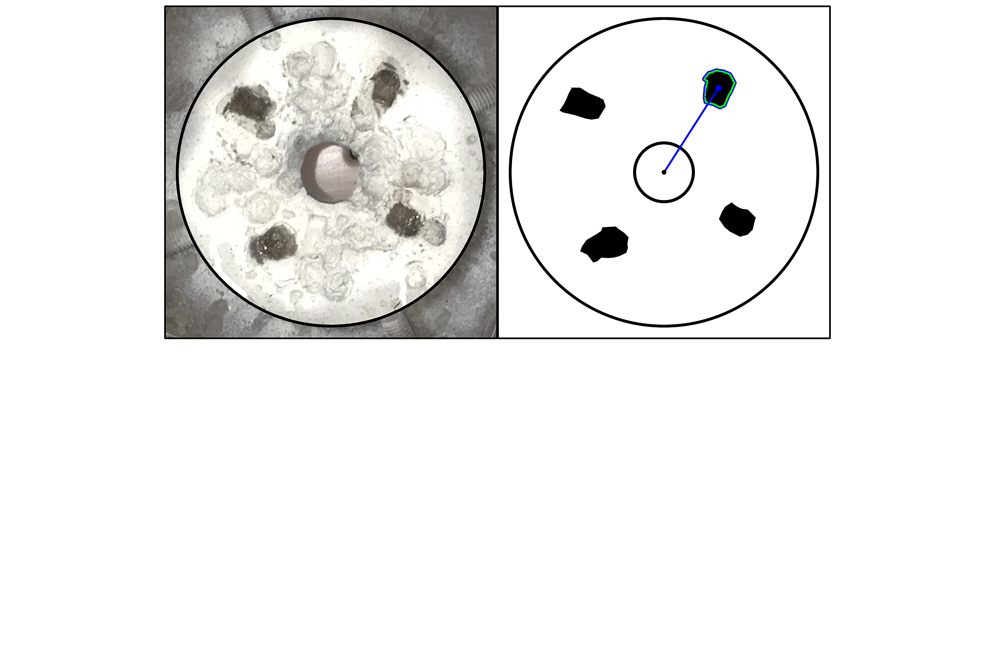
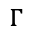
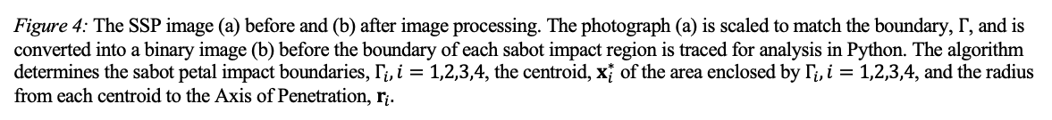
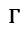
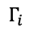
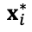
Figure 4
(a)
y
(b)
y
Sabot impact
x
$$x_{i}^{∗}$$
x
Figure 4: The SSP image (a) before and (b) after image processing. The photograph (a) is scaled to match the boundary, $Γ$, and is converted into a binary image (b) before the boundary of each sabot impact region is traced for analysis in Python. The algorithm determines the sabot petal impact boundaries, $Γ_{i}, i=1,2,3,4$, the centroid, $x_{i}^{∗}$ of the area enclosed by $Γ_{i},i=1,2,3,4$, and the radius from each centroid to the Axis of Penetration, $r_{i}.$
2
2
$$Γ_{i}$$
2
1
$$r_{i}$$
2
1
1
AoPF
Ø31.8 mm
4
4
4
4
3
3
Ø152.4 mm
Photograph
$$Γ$$
Binary Image
$$Γ$$

Slide 5
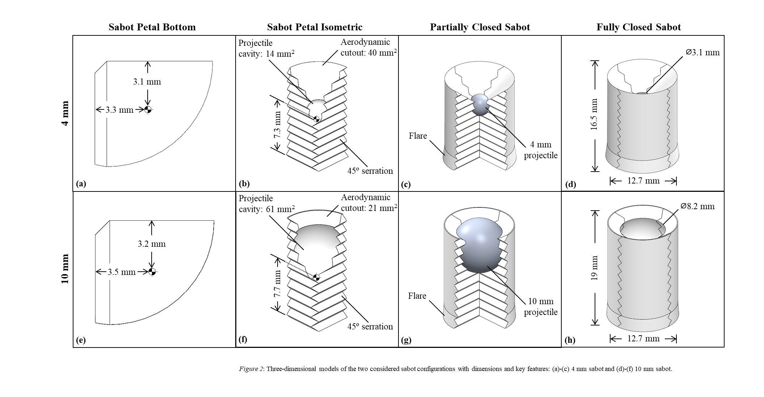
Summary
$$Degree of Separation \left(DoS\right)=F(velocity, pressure,{Area}_{projected, initial})$$
Initial projected area is determined by sabot size
Binary state of 4 mm or 10 mm projectile
Given sabot size and velocity, lab calculates backfill pressure

Slide 6
Summary (cont.)
3 possible outcomes:
Sabot doesn’t separate enough and travels to target tank
Failure Mode I
Too small of pressure for given velocity and sabot size
Excessive aerodynamic forces break up the sabot
Failure Mode II
Too large of pressure for given velocity and sabot size
Sabot separates cleanly and projectile continues to target tank
Goldilocks pressure range

Slide 7
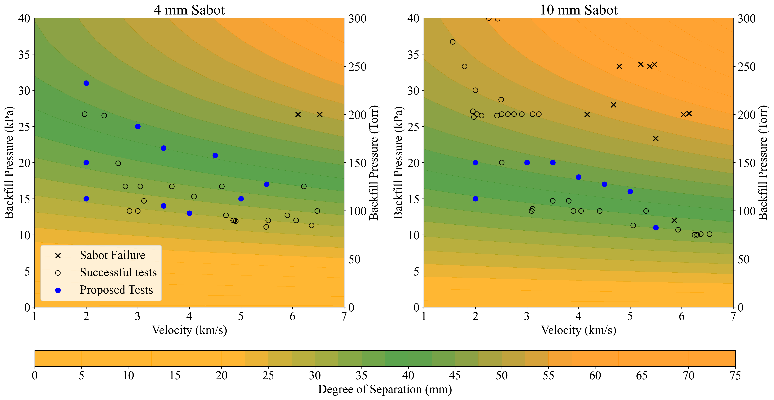
Figure 5
Figure 5
(a)
(b)
(c)
(d)

Slide 8
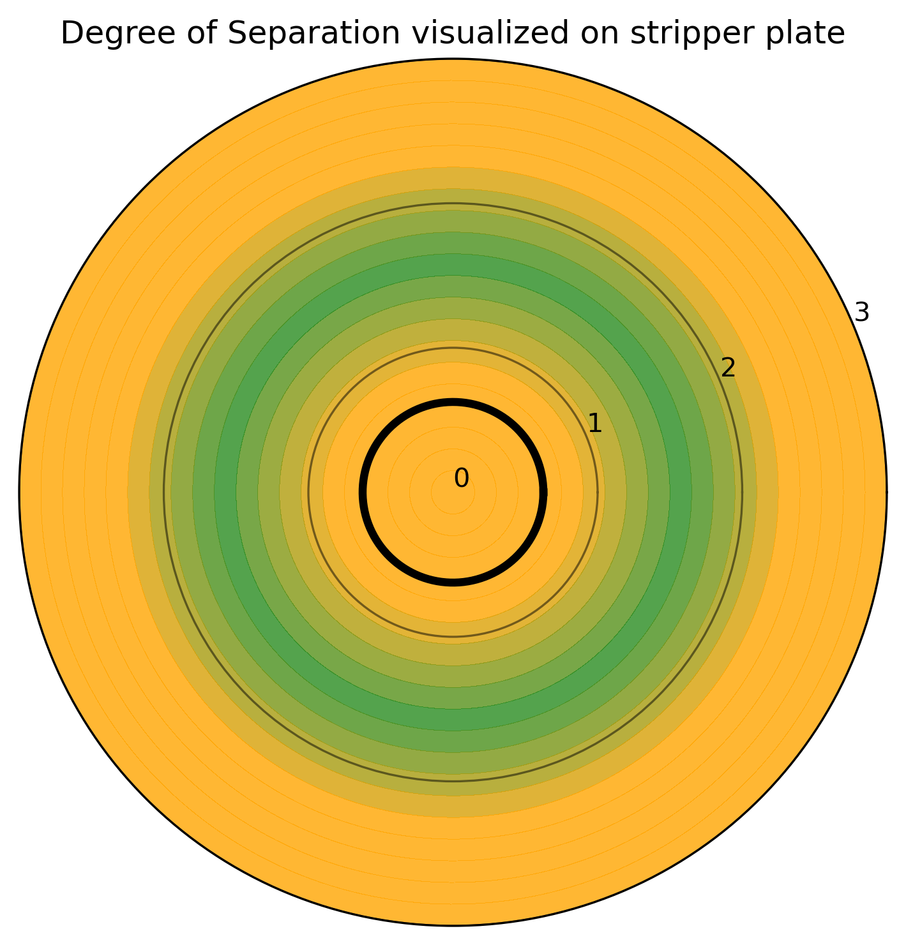
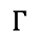
Figure 6
y
x
AoP
Ø31.8 mm
Ø152.4 mm
$$Γ$$

Slide 9
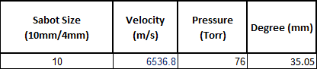
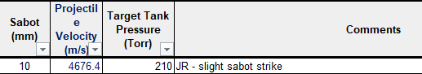
3 types of data
Successful tests:
Have input variables
Have measured DoS
Failed tests:
Have input variables
No measured DoS but do have failure mode
Synthetic data point:
Known from aerodynamic/natural laws
If pressure = 0, no degree of separation

Slide 10
Questions
Training/Testing split for N = ~56?
DF = 3, so rule of 10 says > 30 in training

Slide 11
Questions
Encoding categorical variable (sabot size = 10 or = 4) for ML?
For stats I was doing this binary (0 and 1)

Slide 12
Questions
Synthetic data?
At any sabot size and velocity:
If pressure = 0, DoS = 0
Do I “zero” it out like an excel graph (set trendline origin)?

Slide 13
Questions
Overfitting?
Other thoughts?

Slide 14







"There is nothing more fulfilling than to serve your country and your fellow citizens and to do it well.” – Pres. George H.W. Bush
Contact Information: Director Manager
Dr. Tom Lacy, MEEN Dr. Raj Kota, BCDC
TELacyJr@TAMU.edu KKRaj@TAMU.edu
(662) 948-9213 (cell) (662) 617-9196 (cell)

